Slide 1
Tourism and cities
Team members:Narynbek,Ruslan,Galymbek

Slide 2
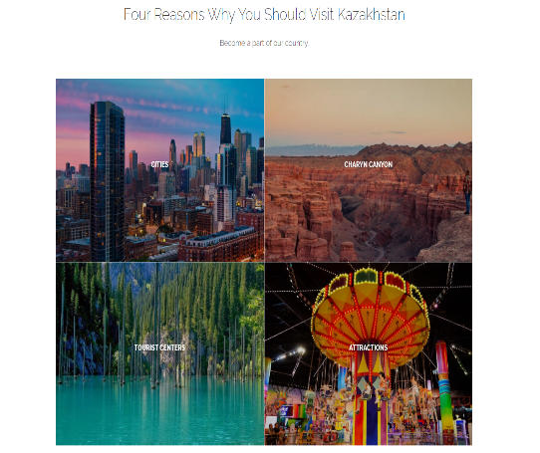
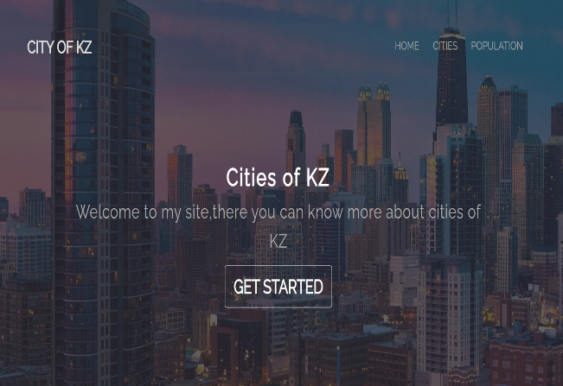
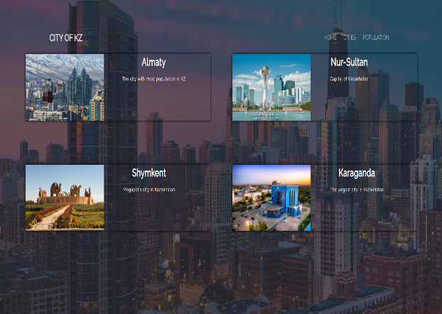
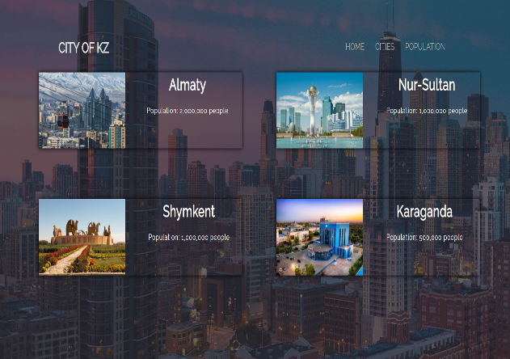
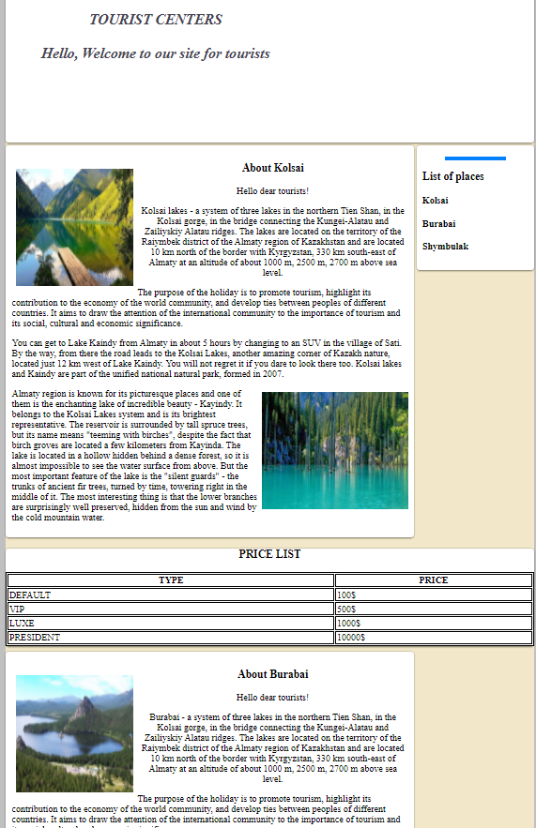
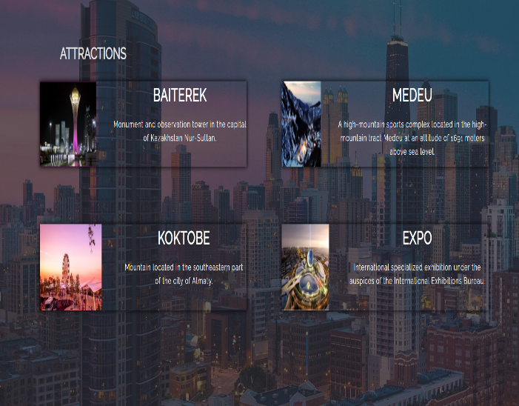
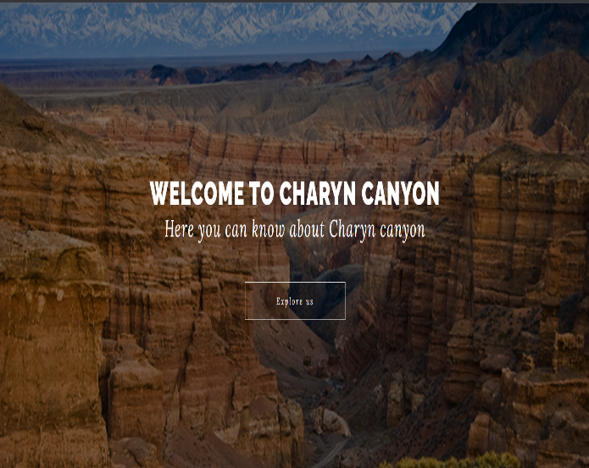
PAGES Number of pages:7

Slide 3
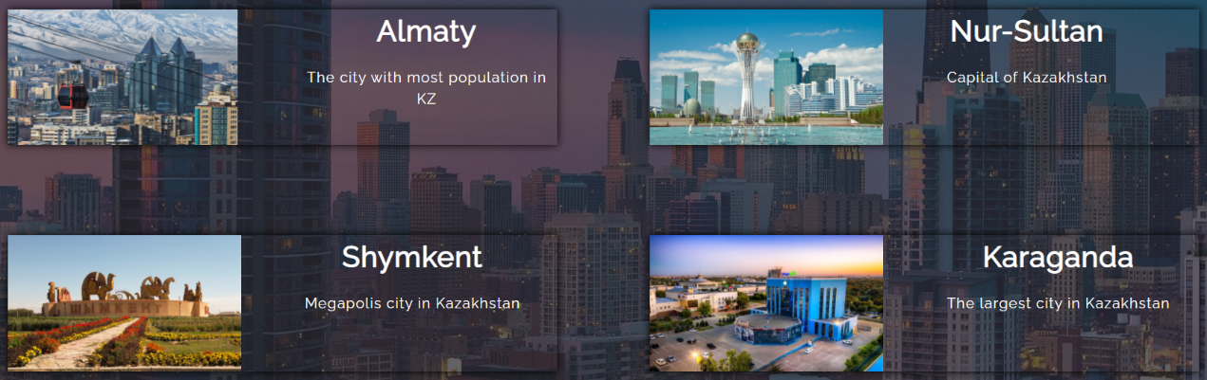
Flexbox containers
display: flex;
flex-direction: row;

Slide 4

Bootstrap grid system
<div class="container">
<div class="row">
<div class="col-lg-12 text-center">
</div>
</div>
<div class="row">
<div class="col-md-6">
</div>
<div class="col-md-6">
</div>
</div>
</div>
2x

Slide 5
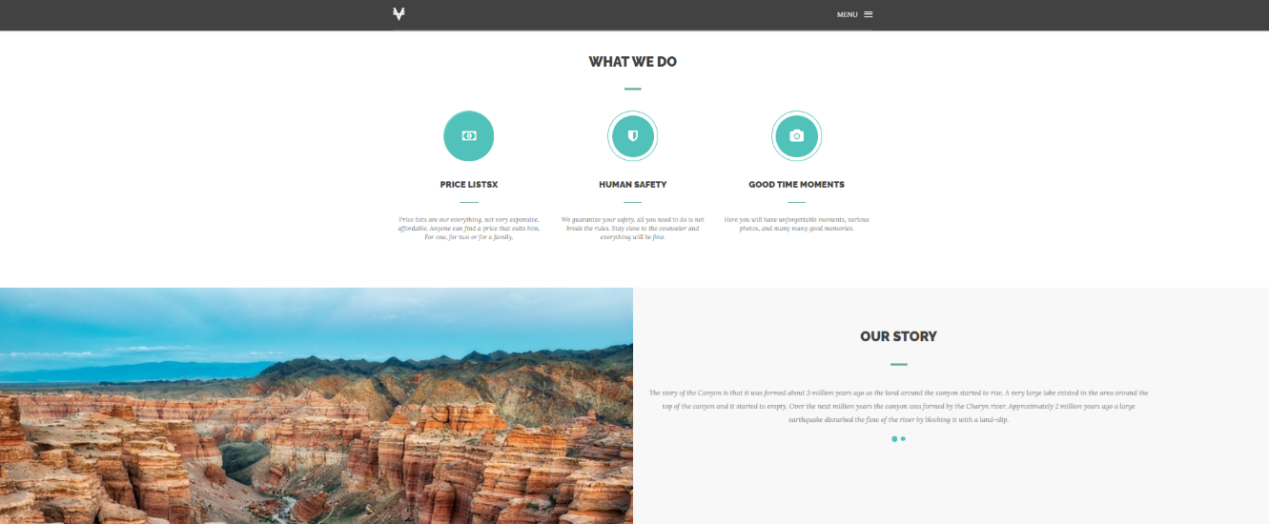
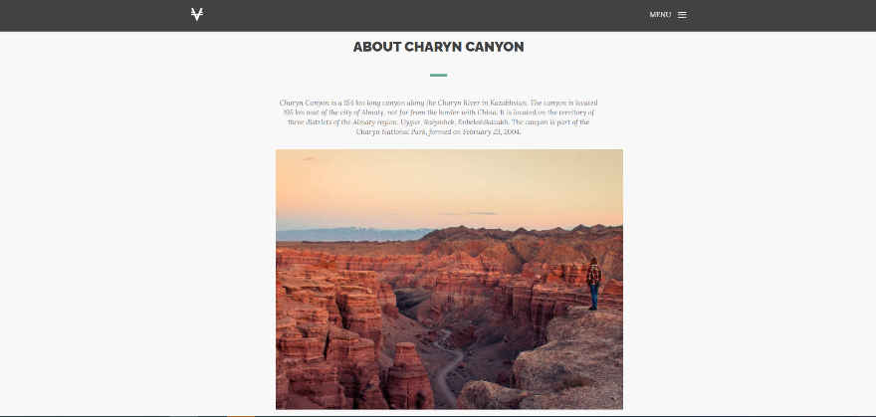
<div class="col-xs-6">
</div>
<div class="col-xs-6 text-right">
</div>
<div class="col-sm-4">
</div>
<div class="col-sm-4">
</div>
<div class="col-sm-4">
</div>
.col- (extra small devices - screen width less than 576px)
.col-sm- (small devices - screen width equal to or greater than 576px)
.col-md- (medium devices - screen width equal to or greater than 768px)
.col-lg- (large devices - screen width equal to or greater than 992px)
.col-xl- (xlarge devices - screen width equal to or greater than 1200px)
<div class="col-sm-8 col-sm-offset-2">
</div>

Slide 6



Buttons and tables
<a class="btn vira-btn" href="#">Explore us</a>
<a href="cities.html“class="btn btn-outline-light btn-lg"href="cities.html"role="button">
GET STARTED</a>
<a href="index1.html" class="btn btn-light btn-block" href="#" role="button"><li>home</li></a>
<a href="#about" class="btn btn-light btn-block" href="#" role="button"><li>about</li></a>
<a href="#expertise" class="btn btn-light btn-block" href="#" role="button"><li>Story</li></a>
<a href="#contact" class="btn btn-light btn-block" href="#" role="button"><li>Address</li></a>
<a href="#contact" class="btn btn-light btn-block" href="#" role="button"><li>contact</li></a>

Slide 7
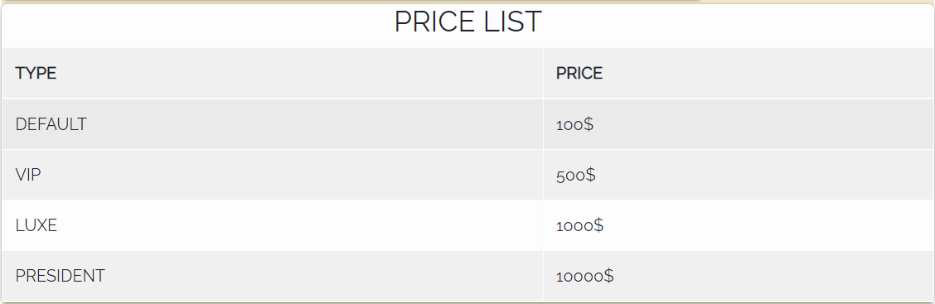
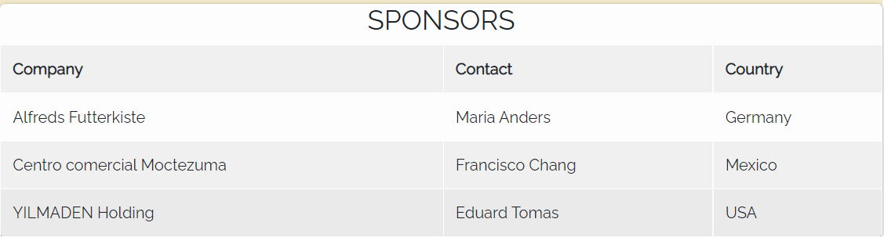
Buttons and tables
3x
<div class="table table-hover table-light table-striped">
</div>

Slide 8

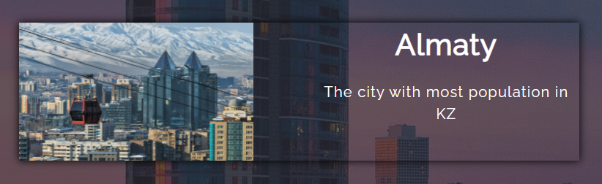
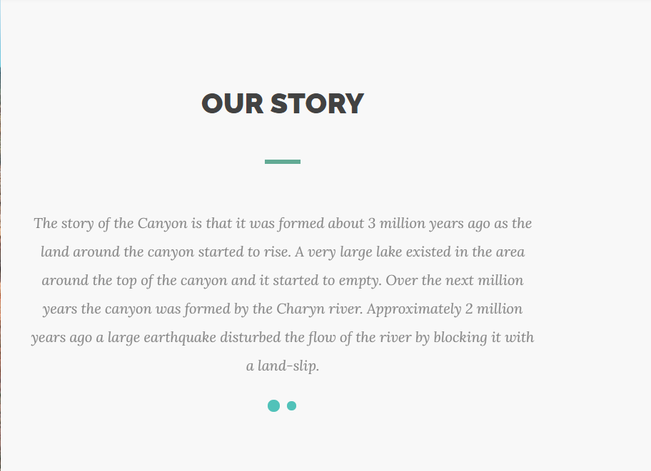
Colors
border-color: #51c2b9;
border-bottom: 1px solid rgba(255, 255, 255, 0.2);
box-shadow:0 0 9px rgb(0, 0, 0);
Hue-saturation-lightness-alpha
background-color: hsla(0, 0%, 97%, 1);
background-color: hsl(36, 20%, 95%);

Slide 9


Mobile adaptive
@media (min-width: 768px) {
section {
padding: 150px 0;
}
}

Slide 10
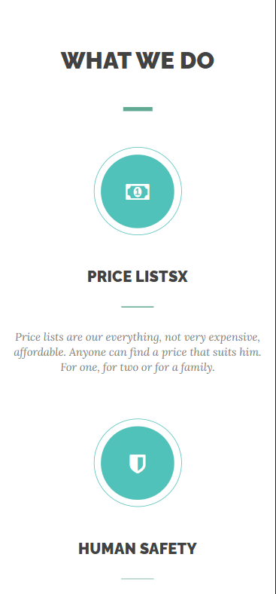

Mobile adaptive
@media (max-width: 767px){
.vira-card{
margin-bottom: 60px;
}
}

